Slide 1
MAGESH R
Final Project
3/21/2024 Annual Review

Slide 2
PROJECT TITLE
Exploring 3D Classification and Segmentation in Computed Tomography for Medical Imaging
3/21/2024 Annual Review

Slide 3


AGENDA
PROBLEM STATEMENT
PROJECT OVERVIEW
WHO ARE THE END USERS?
YOUR SOLUTION AND ITS VALUE PROPOSITION
THE WOW IN YOUR SOLUTION
MODELLING
RESULTS
3/21/2024 Annual Review

Slide 4

PROBLEM STATEMENT
"Challenges and Opportunities in Leveraging 3D Classification and Segmentation for Enhanced Diagnosis and Treatment Planning in Computed Tomography Imaging"
3/21/2024 Annual Review

Slide 5

PROJECT OVERVIEW
Objective: Develop automated methods using advanced 3D classification and segmentation techniques to improve the analysis of CT scans for medical diagnosis and treatment planning.
Approach:
Data Preparation: Gather diverse CT scan datasets and preprocess them to enhance quality and standardize intensity levels.
Model Development: Design and train 3D convolutional neural network (CNN) architectures for classification and segmentation tasks.
Evaluation: Assess model performance using quantitative metrics and compare results against ground truth annotations.
Clinical Validation: Collaborate with medical professionals to validate the accuracy and clinical relevance of the automated tools.
3/21/2024 Annual Review

Slide 6
WHO ARE THE END USERS?
Radiologists: These medical professionals specialize in interpreting medical images, including CT scans. They can use the automated tools to expedite the analysis process and improve diagnostic accuracy.
Clinicians: Physicians and surgeons involved in patient care can benefit from the automated tools for treatment planning and monitoring, particularly in areas such as oncology, neurology, and orthopedics.
Medical Researchers: Professionals conducting research in medical imaging, disease diagnosis, and treatment outcomes can utilize the automated tools to analyze large datasets efficiently and explore new avenues in healthcare.
Healthcare Institutions: Hospitals, clinics, and healthcare facilities can integrate the automated tools into their imaging departments to streamline workflows, reduce manual errors, and enhance overall efficiency in patient care.
3/21/2024 Annual Review

Slide 7
YOUR SOLUTION AND ITS VALUE PROPOSITION
Value Proposition:
Time Saving: Our tool automates the tedious task of analyzing CT scans, saving healthcare professionals valuable time.
Accuracy: With advanced algorithms, our solution ensures precise identification of anatomical structures and abnormalities, reducing the likelihood of errors.
Efficiency: Integrating seamlessly into existing workflows, our tool streamlines processes, enhancing overall efficiency in healthcare settings.
Cost-Effectiveness: By minimizing manual labor and improving diagnostic accuracy, our solution offers cost savings for healthcare providers.
Empowerment: Our user-friendly tool empowers medical professionals, enabling them to focus more on patient care and research, ultimately improving healthcare outcomes.
3/21/2024 Annual Review

Slide 8
THE WOW IN YOUR SOLUTION
Value Proposition:
Instant Precision: Our cutting-edge algorithms swiftly analyze CT scans with unparalleled accuracy, providing instant insights into anatomical structures and anomalies.
Effortless Integration: Seamlessly integrating into existing workflows, our solution effortlessly enhances efficiency, revolutionizing the way healthcare professionals approach CT image analysis.
Beyond Boundaries: Pushing the boundaries of traditional methods, our solution not only saves time but also unlocks new possibilities in diagnosis, treatment planning, and medical research.
Unleashing Potential: Empowering medical professionals with intuitive tools, our solution unleashes their potential, enabling them to deliver exceptional patient care and drive groundbreaking advancements in healthcare.
The Future of Imaging: With our solution, the future of CT imaging is here — where precision meets efficiency, and healthcare reaches new heights of excellence.
3/21/2024 Annual Review

Slide 9
MODELLING
Overview: Our approach employs advanced deep learning techniques to create accurate and efficient models for analyzing CT scans. By using convolutional neural networks (CNNs) and segmentation methods, we ensure precise identification of structures and abnormalities.
Key Components:
CNNs:
We use 3D CNN architectures to capture spatial relationships in CT scans and extract relevant features.
These networks are trained to recognize patterns indicative of different anatomical structures or abnormalities.
Segmentation Techniques:
Segmentation methods like U-Net are employed to precisely outline organs and lesions in CT images.
These techniques ensure detailed and accurate delineation of regions of interest.
Data Augmentation:
To improve model robustness, we augment the dataset with variations like rotation and scaling.
Augmentation helps the model generalize better to unseen data and diverse patient conditions.
3/21/2024 Annual Review

Slide 10
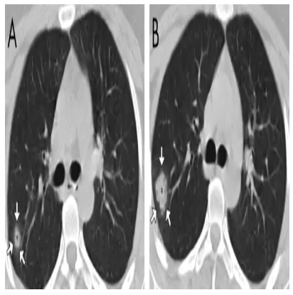
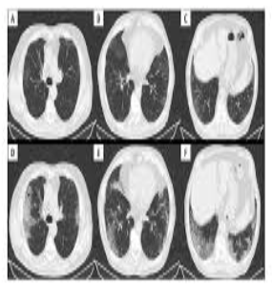

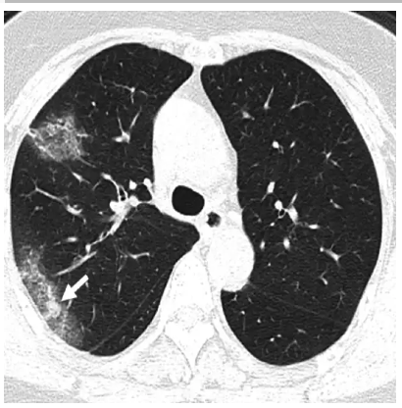
RESULTS

